Slide 1






ARDUINO https://www.arduino.cc/
+91-9996492589
@DEV__Ankur
@ankuraxz
@ankuraxz
@ANKURaxz
Ankur

Slide 2
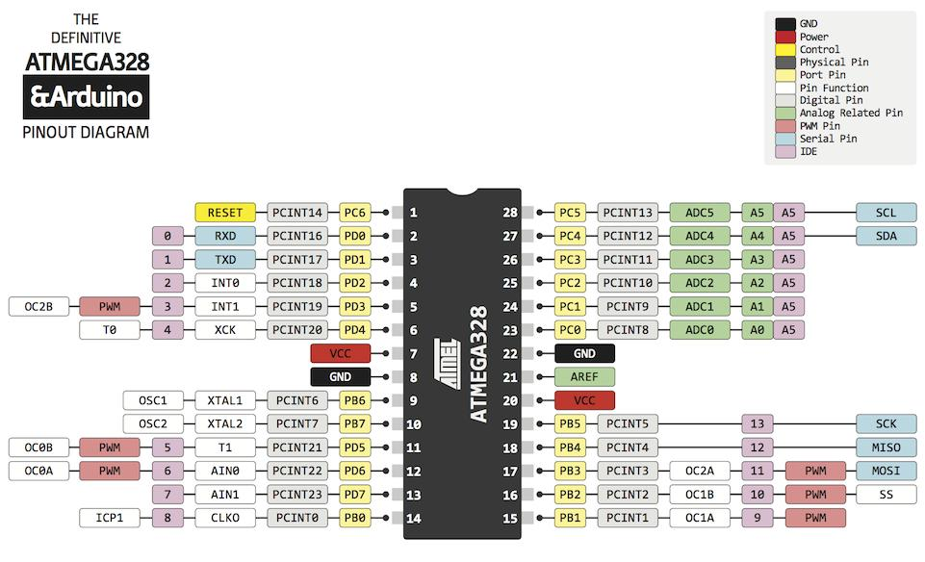
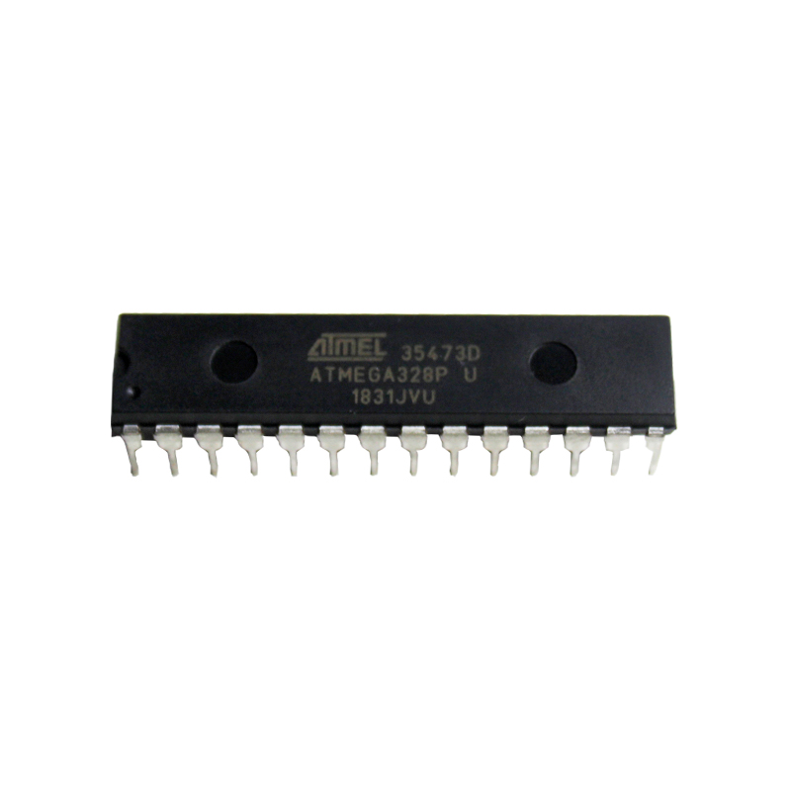
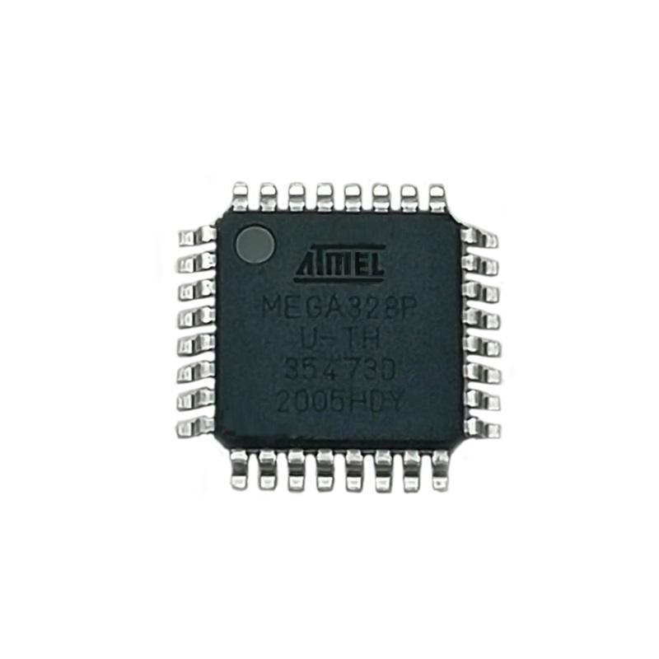
Microcontroller
A microcontroller is a compact integrated circuit designed to govern a specific operation in an embedded system.
A typical microcontroller includes a processor, memory and input/output (I/O) peripherals on a single chip.
ATMEL ATMEGA328-P
DIP - THT
QFP - SMT

Slide 3
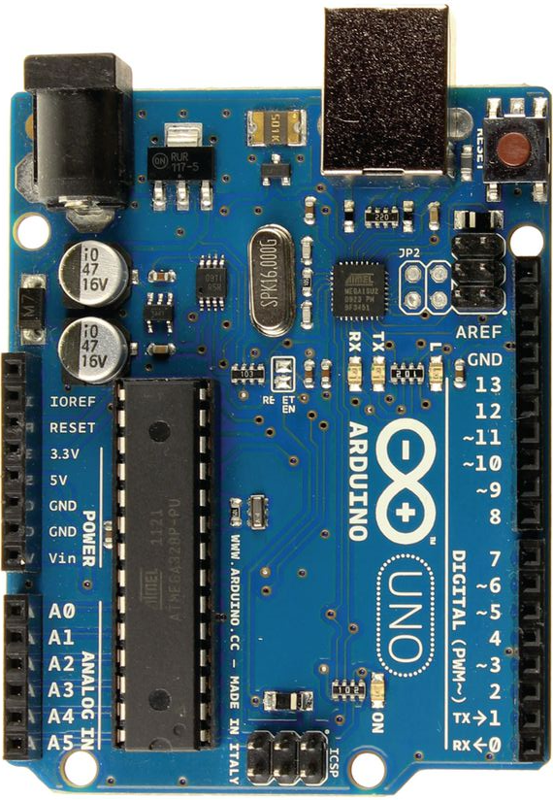
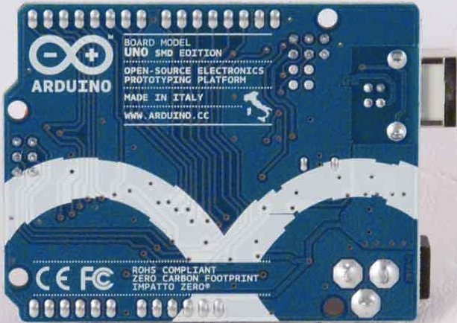
Arduino

Slide 4
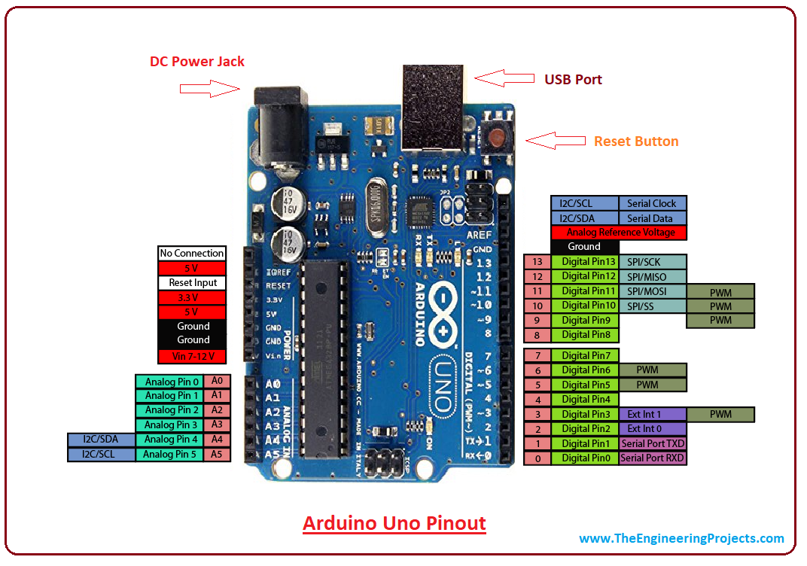

Slide 5
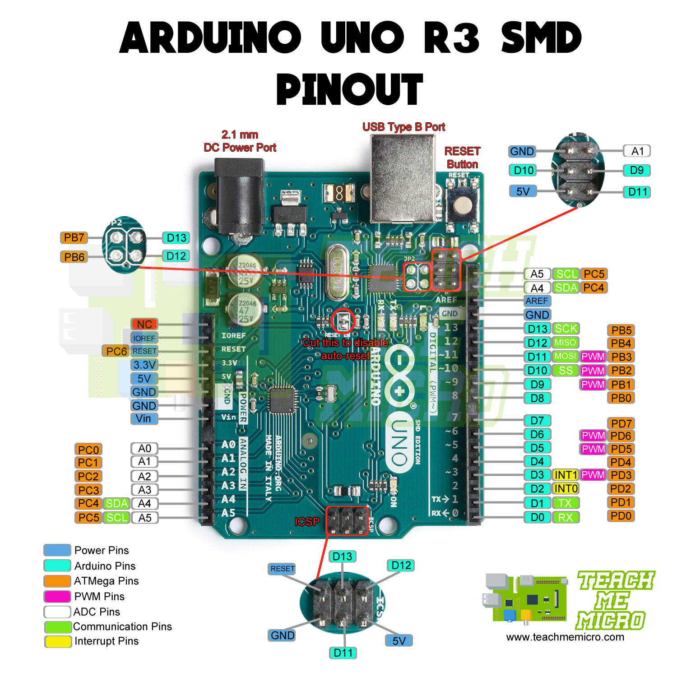

Slide 6
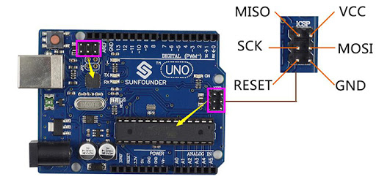

Slide 7
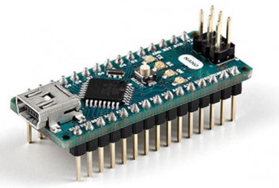
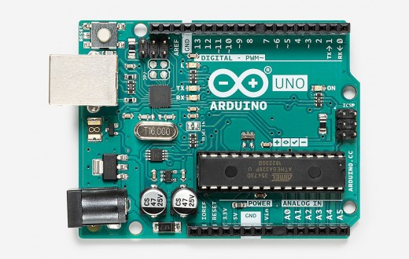
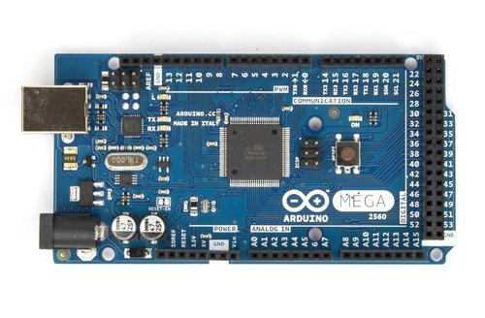
Arduino

Slide 8
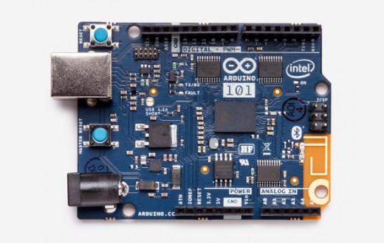
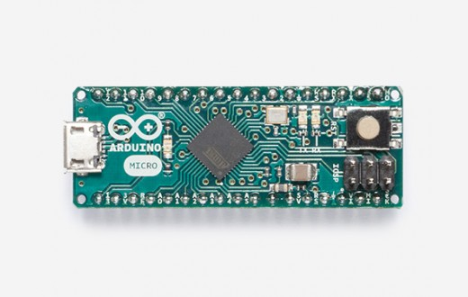
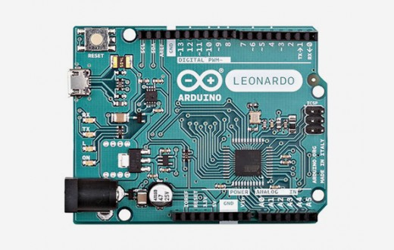
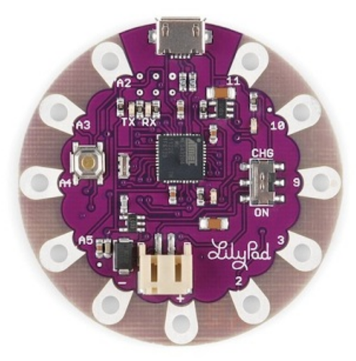
Few others: https://www.arduino.cc/en/Main/Products

Slide 9
Do Read
Different Arduino’s, Projects on www.arduino.cc
Arduino Language Guide
Arduino → Open Source
Arduino Shields
Sparkfun and Adafruit Shields
Arduino MKR series
About Arduino IDE

Slide 10
LINKS
https://github.com/Ankuraxz/NASSCOM-MHRD-IOT-Practical-Module_1-2
https://www.youtube.com/watch?v=nL34zDTPkcs
https://www.youtube.com/playlist?list=PLGs0VKk2DiYw-L-RibttcvK-WBZm8WLEP
https://www.tinkercad.com/dashboard
www.Arduino.cc

Slide 11
BASIC SENSORS IR, PIR, LDR, AMBIENT LIGHT
+91-9996492589
@DEV__Ankur
@ankuraxz
@ankuraxz
@ANKURaxz
Ankur

Slide 12
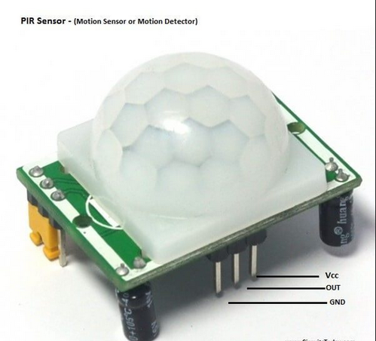
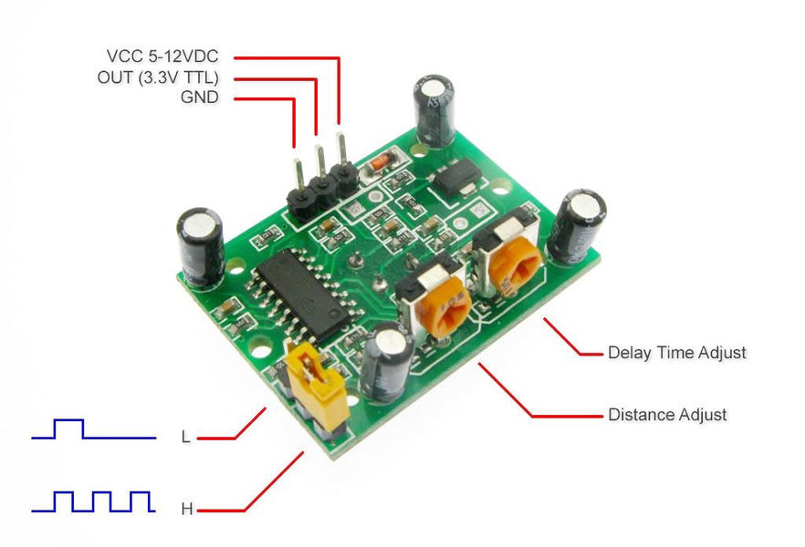
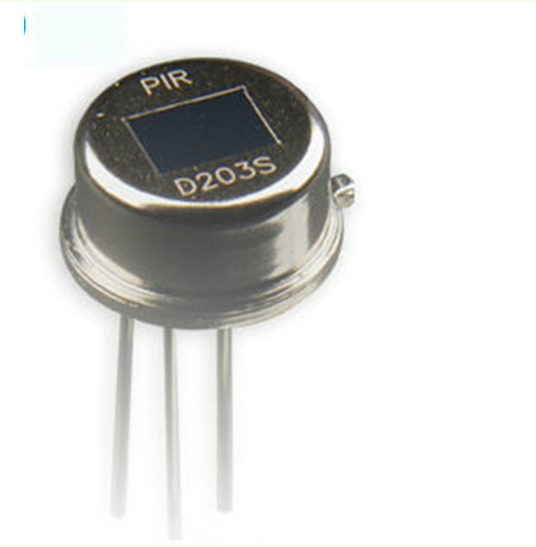
PIR - HC-SR501 PIR Sensor

Slide 13
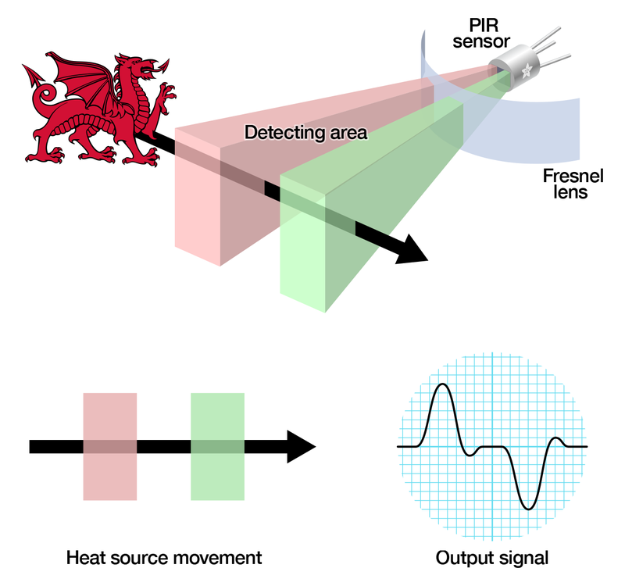

Slide 14
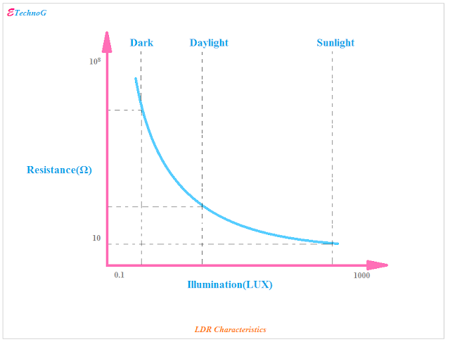
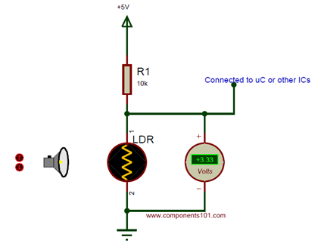
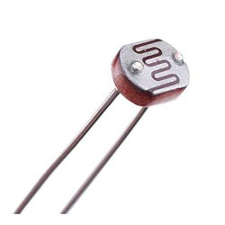
Light Dependent Resistor(LDR) PhotoResistor – NORP12

Slide 15
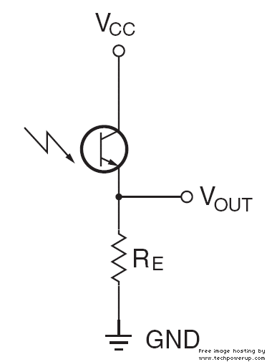
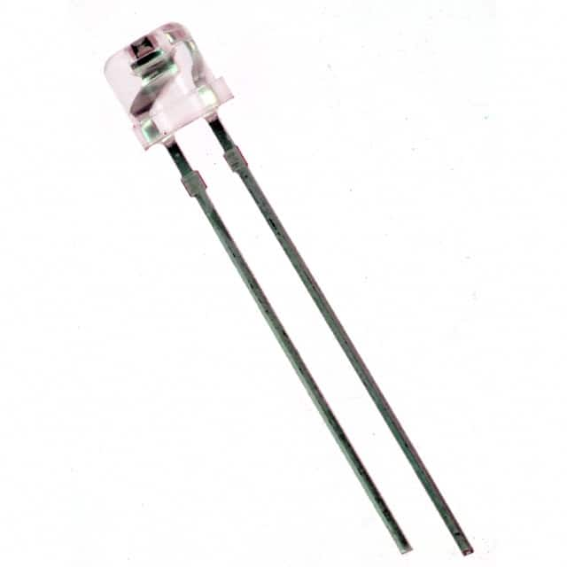
AMBIENT LIGHT SENSOR (PhotoDiodes) TEPT-5700

Slide 16
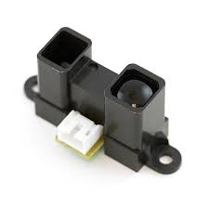
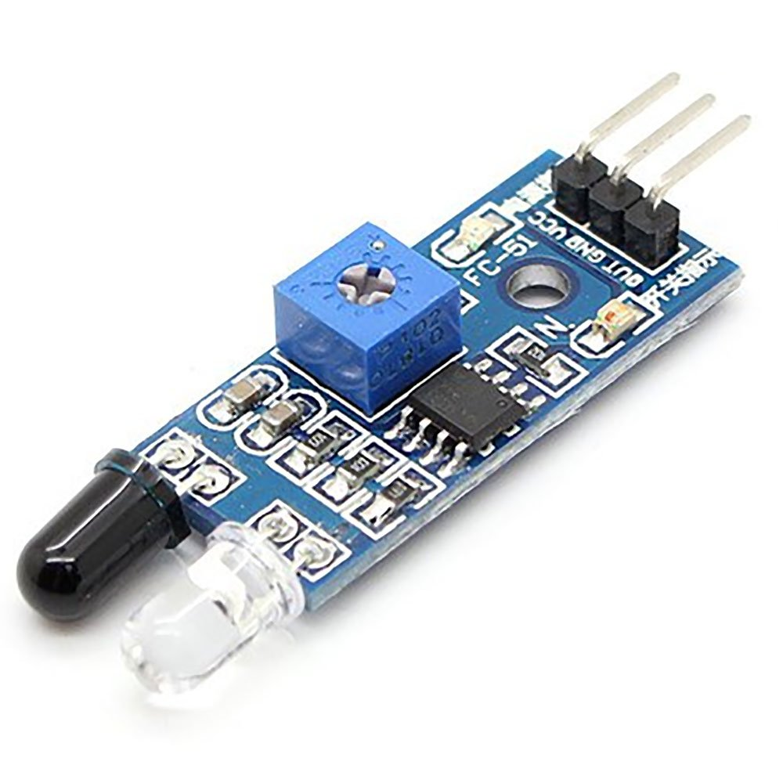
IR/Proximity Sensor IR

Slide 17
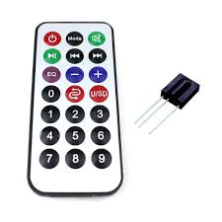
IR Remote REMOTE https://wonderopolis.org/wonder/how-does-a-remote-control-work https://create.arduino.cc/projecthub/electropeak/use-an-ir-remote-transmitter-and-receiver-with-arduino-1e6bc8

Slide 18
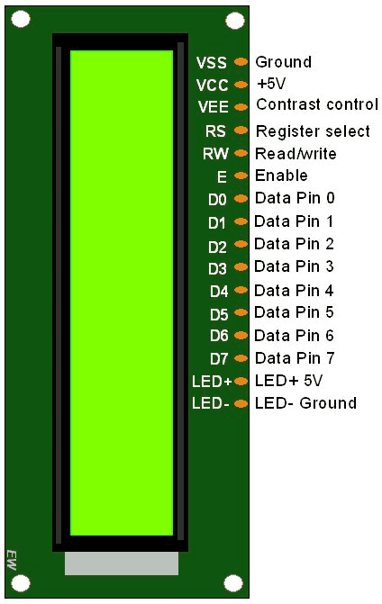
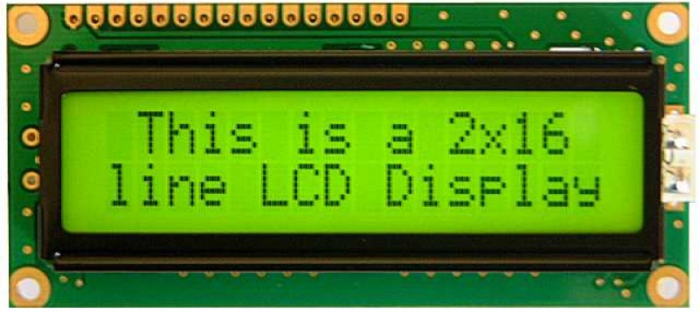
LCD 2X16 https://components101.com/16x2-lcd-pinout-datasheet

Slide 19
ADVANCED SENSORS ULTRASONIC AND TEMPERATURE SENSORS
+91-9996492589
@DEV__Ankur
@ankuraxz
@ankuraxz
@ANKURaxz
Ankur

Slide 20
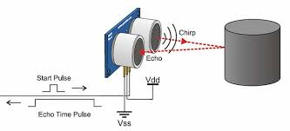
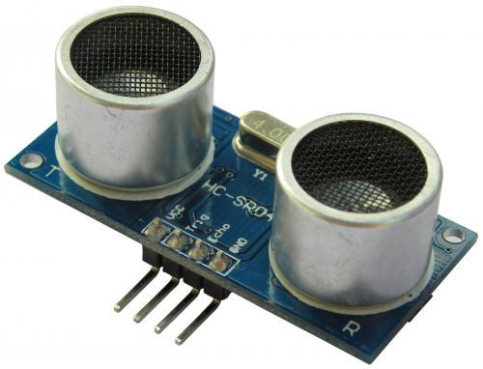
Ultrasonic sensor HC–SR04

Slide 21
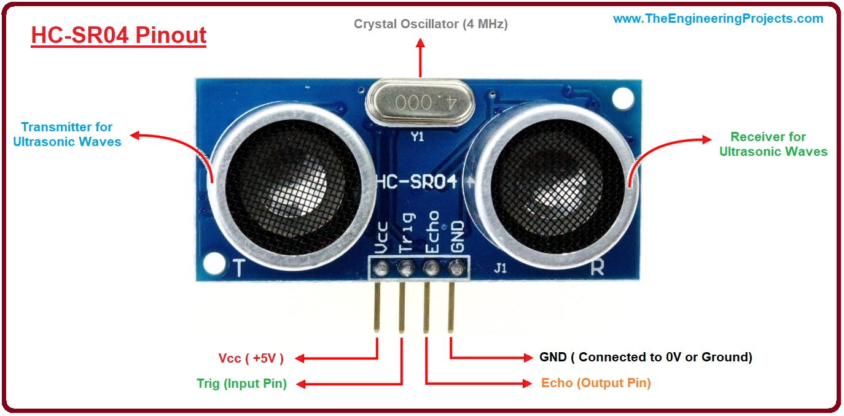

Slide 22
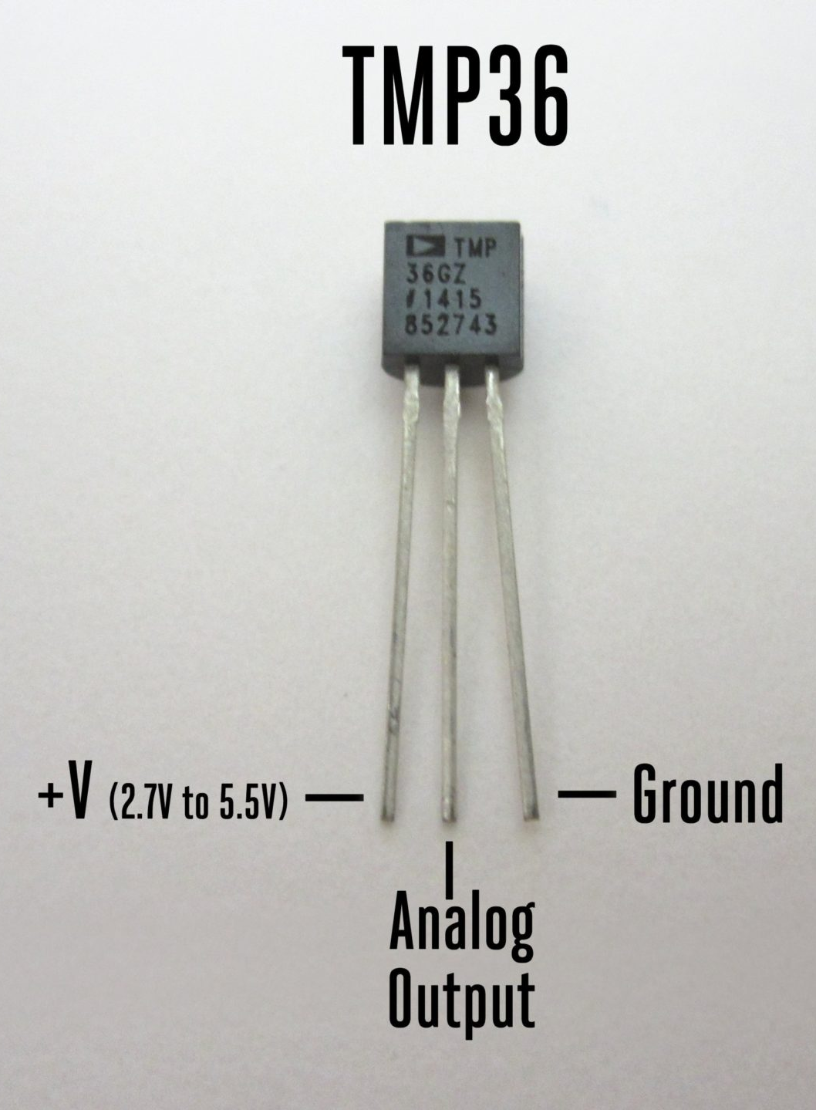
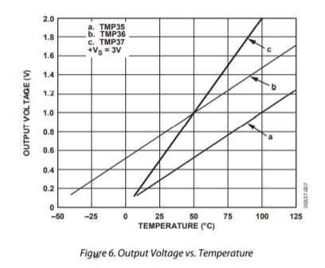
Temperature Sensor TMP36, LM35

Slide 23
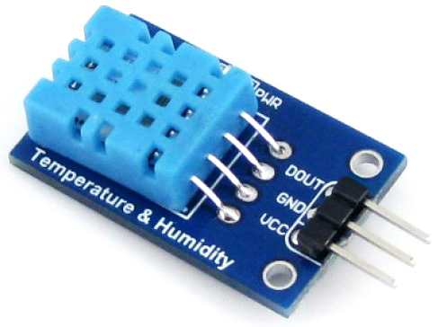
Digital Temperature and Humidity Sensor DHT11 https://www.quora.com/How-does-DHT-11-sensor-work-how-is-humidity-sensed-by-its-sensor-working-material-used-and-temperature

Slide 24
MOTORS SERVO, STEPPER AND DC MOTOR
+91-9996492589
@DEV__Ankur
@ankuraxz
@ankuraxz
@ANKURaxz
Ankur

Slide 25
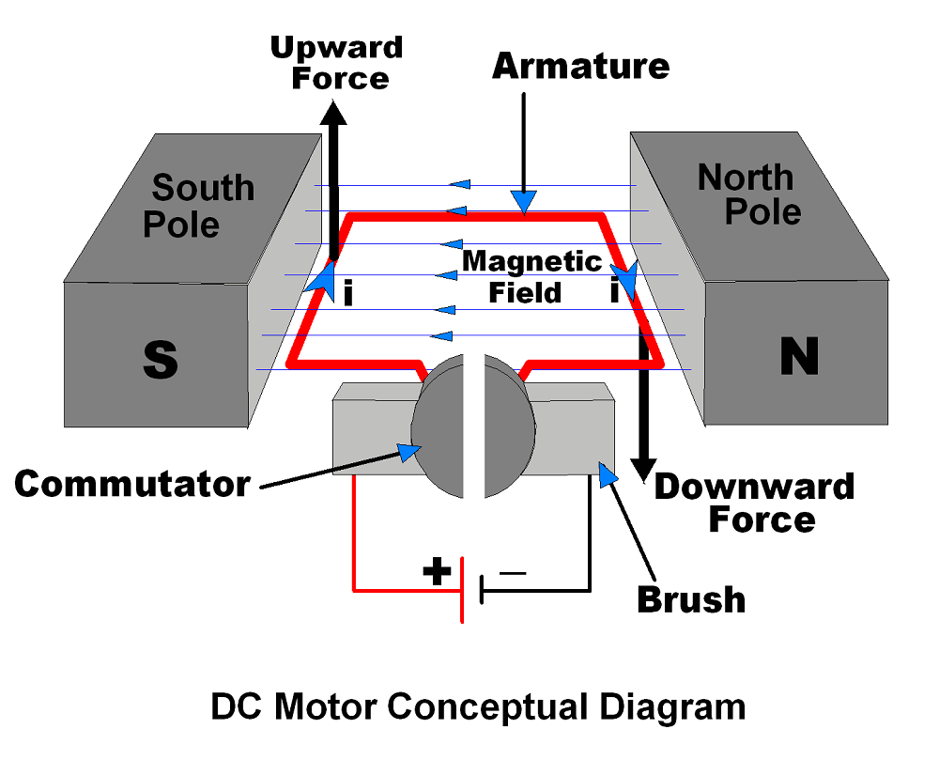
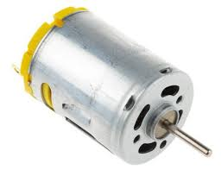
DC Motor

Slide 26
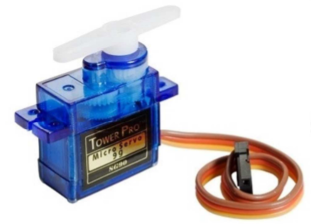
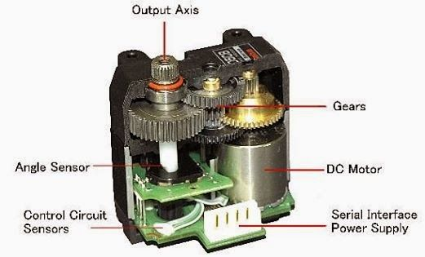
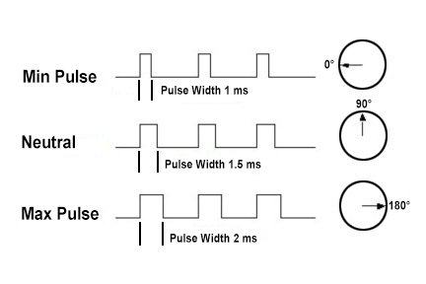
Servo Motor https://datasheetspdf.com/pdf-file/791970/TowerPro/SG90/1 https://www.jameco.com/Jameco/workshop/howitworks/how-servo-motors-work.html
Servos are controlled by sending an electrical pulse of variable width, or pulse width modulation (PWM), through the control wire. There is a minimum pulse, a maximum pulse, and a repetition rate. A servo motor can usually only turn 90° in either direction for a total of 180° movement. The motor's neutral position is defined as the position where the servo has the same amount of potential rotation in the both the clockwise or counter-clockwise direction. The PWM sent to the motor determines position of the shaft, and based on the duration of the pulse sent via the control wire; the rotor will turn to the desired position. The servo motor expects to see a pulse every 20 milliseconds (ms) and the length of the pulse will determine how far the motor turns.

Slide 27
PWM AND SERVO

Slide 28
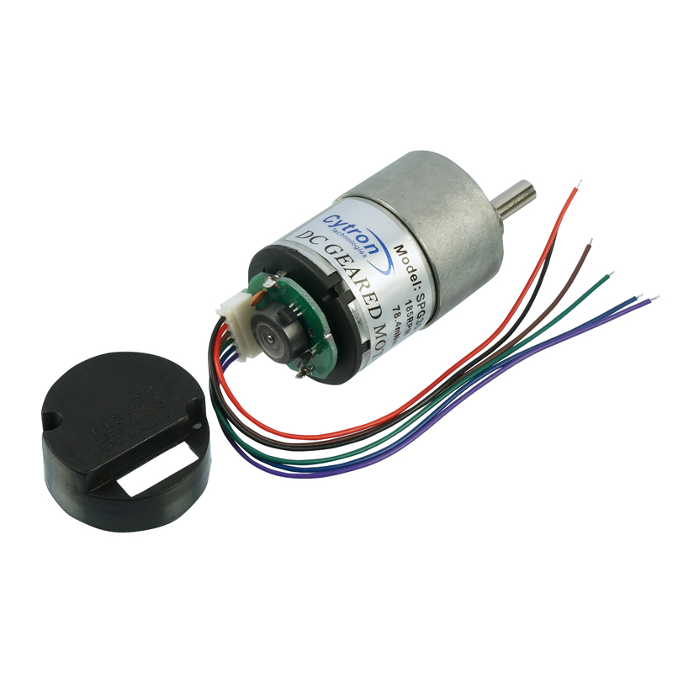
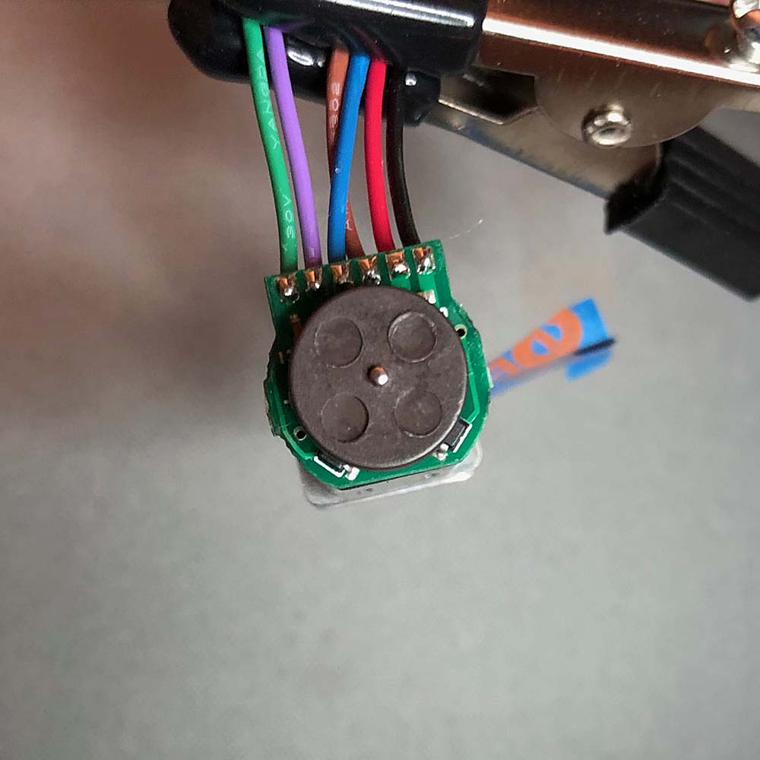
Encoded Geared DC Motor https://www.element14.com/community/community/arduino/blog/2020/01/02/simple-arduino-dc-motor-control-with-encoder-part-1
The encoder uses hall effect sensors to detect the passage of four magnets which are encased in the disk as seen in the photo.

Slide 29
Other Important Motors
Stepper Motor
BLDC Motor - DRONES

